Slide 1




School of Computer Science & IT
Department of BCA
20BCA1C04 COMPUTER FUNDAMENTALS & ORGANIZATION
MODULE I : Introduction to Computers
Faculty : Prof. Apoorva K A
1

Slide 2












2

Slide 3
Syllabus
3
Title | Computer Fundamentals & Organization
Code | 20BCA1C04
Hrs / Week | 4
Credits | 4
Course Objectives:
At the end of the course, the students will be able to:
To explain the basics features of computer.
To understand the computer organization.
To understand the hardware and software of computer
To discuss the application of MS Office
To discuss the types of networks used in computer.

Slide 4
4
Course Outcomes:
On successful completion of the module students will be able to:
Identify the concepts and applications of computers.
Use of computer architecture and its languages efficiently.
Identify the importance of internal organization of computer and problem solving aspects.
Illustrate the networking of computers and IPR concepts.
Design the static webpage and use MS Office efficiently.

Slide 5
Module I : Introduction to Computers 8 Hours
5
General features of a computer.
Generation of computers, Personal computer, workstation, mainframe computer and super computers.
Computer applications, Data processing, information processing, commercial, office
automation, industry and engineering, healthcare, education, graphics and multimedia.

Slide 6
Module II : Computer organization and security
6
14 Hours
Computer organization - central processing unit- general structure, power consumption, ALU, Registers, Control Unit, Instruction format, Instruction set, Instruction cycle
Computer memory – primary memory and secondary memory. Secondary storage devices –
magnetic and optical media.
Input and output units, OMR, OCR, MICR, scanner, mouse, modem.
Computer hardware and software.
Machine language and high level language.
Application software, computer program, operating system.
Computer virus, antivirus and computer security.
Introduction to microprocessors – RISC and CISC.

Slide 7
Module III : Problem Solving and Flip-flops 16 Hours
7
Computer arithmetic, binary, decimal, octal and hexadecimal number systems
Algorithm and flowcharts, illustrations, elements of a database and its applications
Basic Gates (De-Morgan’s theorems, duality theorem, NOR, NAND, XOR, XNOR gates) Boolean expressions and logic diagrams, Types of Boolean expressions, SOP & POS, Karnaugh map simplification methods
Flipflops – RS, JK, T and D

Slide 8
Module IV : Computer Networks and IPR 12 Hours
8
Network of computers- Types of networks, Intranet and Internet.
Internet applications- World wide web, E-mail, browsing and searching, search
engines, multimedia applications
Communication Concepts- networking devices, SIM, GPRS, CDMA, GPS, GSM
Introduction to Open Source, IPR – Patents and Copyrights

Slide 9
Module V : Web Designing and MS- Office 10 Hours
9
Introduction to Web designing HTML – text, fonts, images, tables, forms.
Word processing and electronic spread sheet. An overview of MS WORD, MS
EXCEL and MS POWERPOINT.

Slide 10
Reference
10
V. Carl Hamacher, Z.G(2002), Computer Organization, India: McGraw-hill
Anita Goel and Ajay Mittal (2013), Computer Fundamentals and Programming in C, Pearson Education, Inc.
Stallings. W (2010), Computer Organization and Architecture, New Jersy: Pearson Education, Inc.
V. Rajaraman(2010), Fundamentals of Computers, 5th Edition, India:Prentice Hall.
Chaudhari, P.P(2009), Computer Organisation and Design, 3rd Edition, India: PHI Learning.
Alexis Leon: Computers for everyone. Vikas, UBS
Anil Madaan : Illustrated Computer Encyclopedia. Dreamland Pub
Sinha. Computer Fundamentals BPB Pub.
Thomas A. Powell, HTML & CSS: The Complete Reference, Fifth Edition
Michael Price and Mike Mc Grath, Office 2016 In Easy Steps

Slide 11

INTERESTING FACTS

Slide 12
What is a Computer ?
11
Definitions :
The term computer is derived from the word compute, which means to calculate.
The literal meaning of computer is a device that can calculate.
A computer is an electronic device that receives input, stores or processes the input as per user instructions and provides output in desired format.
A computer is an electronic device that performs diverse operations with the help of instructions to process the data in order to achieve desired results.

Slide 13
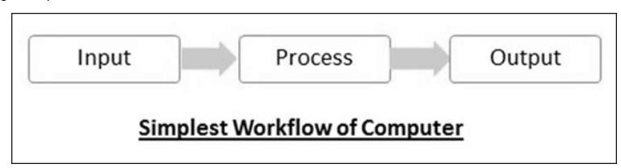
General features of a computer
12
Computer input is called data and the output obtained after processing it, based on user’s instructions is called information.
The processes that can be applied to data are of two types −
Arithmetic operations − Examples include calculations like addition, subtraction, differentials, square root, etc.
Logical operations − Examples include comparison operations like greater than, less
than, equal to, opposite, etc.

Slide 14
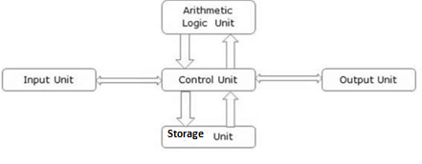
Cont.
13
The basic parts of a computer are −
Input Unit − Devices like keyboard and mouse that are used to input data and instructions to the computer
Output Unit − Devices like printer and visual display unit that are used to provide information to the user in
desired format
Control Unit − Controls all the functions of the computer. All devices or parts of computer interact through the control unit.
Arithmetic Logic Unit − This is the brain of the computer where all arithmetic operations and logical
operations take place.
Memory (Storage) − All input data, instructions and data interim to the processes are stored in the memory. Memory is of two types – primary memory and secondary memory. Primary memory resides within the CPU whereas secondary memory is external to it.
Central Processing Unit(CPU) - Control unit + arithmetic logic unit + memory
Hardware components - devices like keyboard, mouse, printer, etc. that we can see and touch are the of a computer.
Software components - The set of instructions or programs that make the computer function using these hardware parts. We cannot see or touch software.
Jain (Deemed-to-be University), Department of BCA

Slide 15
Characteristics of Computer
14
Speed − A computer can carry out 3-4 million instructions per second.
Accuracy − Computers exhibit a very high degree of accuracy. Errors that may occur are usually due to inaccurate data, wrong instructions or bug in chips . The level of accuracy depends on the instructions and the type of machines being used. Occurrence of wrong result in a computer due to faulty instructions for data processing is known as GIGO (Garbage In Garbage Out).
Reliability - Computer does not require any human intervention between its processing operations.They
have built-in diagnostic capabilities, which help in continuous monitoring of the system.
Versatility − Computers can carry out a wide range of work from data entry and ticket booking to complex mathematical calculations and continuous astronomical observations. If you can input the necessary data with correct instructions, computer will do the processing.
Storage Capacity − Computers can store a very large amount of data at a fraction of cost of traditional
storage of files. Also, data is safe from normal wear and tear associated with paper.
Resource Sharing: Computers have the capability to connect with each other and share devices ,data etc. among the group.
Diligence: Computer, being a machine, does not suffer from the human traits of tiredness and lack of concentration.
Jain (Deemed-to-be University), Department of BCA

Slide 16
Advantages of Using Computer
15
Computers can do the same task repetitively with same accuracy.
Can store vast amounts of information and reduce waste
Helps sort, organize, and search through information
Keeps you connected
Save time
Computers can take up routine tasks while releasing human resource
for more intelligent functions.

Slide 17
Limitations of Using Computer
16
Computers have no intelligence; they follow the instructions blindly
without considering the outcome.
Regular electric supply is necessary to make computers work.
A computer can only perform what it is programmed to do.
The computer needs well-defined instructions to perform any operation. Hence, computers are unable to give any conclusion without going through intermediate steps.
A computer's use is limited in areas where qualitative considerations are important. For instance, it can make plans based on situations and information but it cannot foresee whether they will succeed.

Slide 18
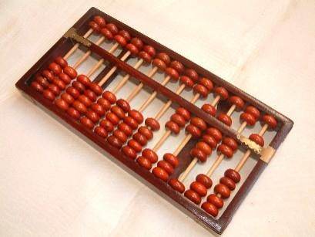
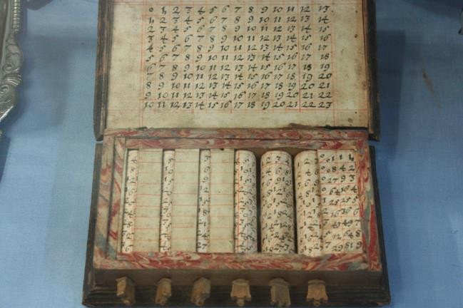
History of Computer
17
1. Calculating Machines
ABACUS was the first mechanical calculating device for counting of large numbers.
The word ABACUS means calculating board
It consists of bars in horizontal positions on which sets of beads are inserted. The horizontal bars have 10 beads each, representing units, tens, hundreds etc.
2. Napier’s Bones
 Mechanical device built for the purpose of multiplication in 1617 by an
English Mathematician John Napier.

Slide 19
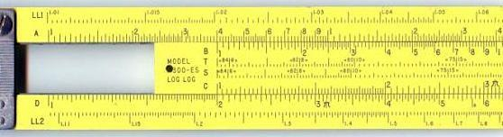
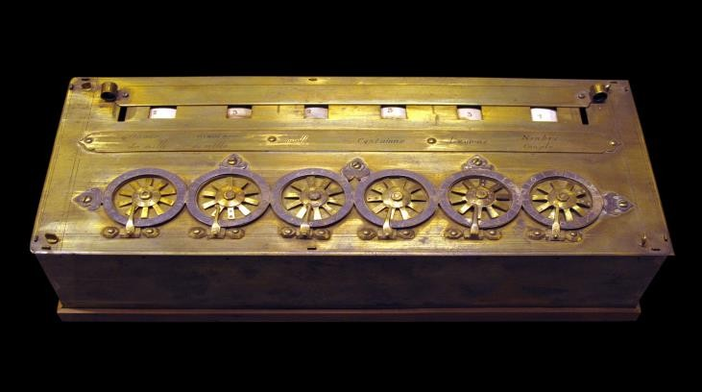
History of Computer Cont…
18
3. Slide Rule
Developed by an English Mathematician Edmund Gunter in the 16th
century.
Using the slide rule, one could perform operations like addition, subtraction, multiplication and division.
It was used extensively till late 1970s.
4. Pascal’s Adding and Subtraction Machine
Developed by Blaise Pascal for addition and subtraction operation.
Machine consisted of wheels , gears and cylinders.

Slide 20
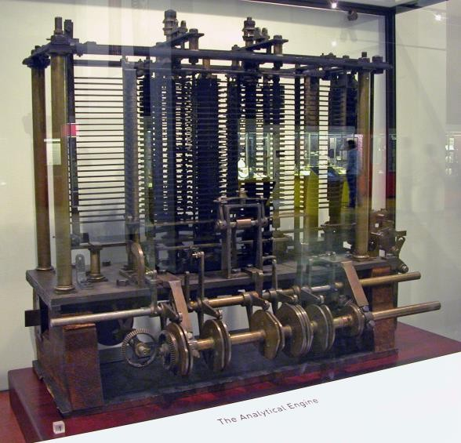






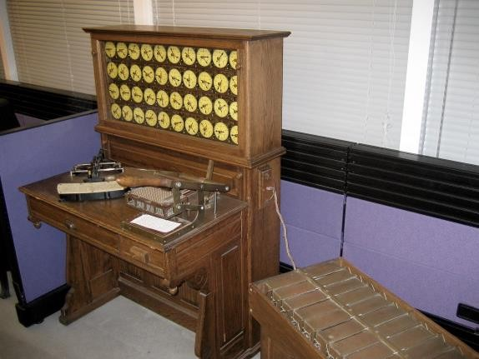
History of Computer Cont…
19
7. Babbage’s Analytical Engine
Built by Charles Babbage in 1823 to do complex mathematical calculations
The machine was called
Later Charles Babbage and Lady Ada Lovelace developed a general-purpose calculating machine, the
Charles Babbage is also called the
8. Hollerith’s Punched Card Tabulating Machine
Invented by Herman Hollerith
The machine could read the information froma punched card and process it electronically
These developments resulted in the development of first computer in the 1940s.

Slide 21
Generations Of Computer
20
Generations of computer is described as a stage of technological
development or innovation.
A major technological development that fundamentally changed the way computers operate, resulting in increasingly smaller, cheaper, more powerful and more efficient and reliable devices, characterizes each generation of computer.
According to the technology used, there are five generations of computers.

Slide 22

FIRST GENERATION (1940–56): VACUUM TUBES
21
Hardware Technology - First generation computers were vacuum tubes/thermionic valve based machines. These computers used vacuum tubes for circuitry and magnetic drums for memory. A magnetic drum is a metal cylinder coated with magnetic iron-oxide material on which data and programs can be stored. Input was based on punched cards and paper tape and output was displayed in the form of printouts.
Software Technology - First generation computers relied on binary-coded language (language of 0s and 1s) to perform operations and were able to solve only one problem at a time.
Each machine was fed with different binary codes and hence were difficult to program. This resulted in lack of versatility and speed.
 To run on different types of computers, instructions must be rewritten or recompiled.

VACUUM TUBES
Examples: Electronic Numerical Integrator and Calculator(ENIAC), Elcetronic Discrete
Variable Automatic Computer(EDVAC), and UNIVersal Automatic Computer(UNIVAC).

Slide 23
Characteristics of First Generation Computers
22
These computers were based on vacuum tube technology.
These were the fastest computing devices of their times (computation time was in milliseconds).
These computers were very large, and required a lot of space for installation.
Since thousands of vacuum tubes were used, they generated a large amount of heat. Therefore, air conditioning was essential.
These were non-portable and very slow equipments.
They lacked in versatility and speed.
They were very expensive to operate and used a large amount of electricity.
These machines were unreliable and prone to frequent hardware failures. Hence, constant maintenance was required.
Since machine language was used, these computers were difficult to program and use.
Each individual component had to be assembled manually. Hence, commercial appeal of these computers was poor.

Slide 24

SECOND GENERATION (1956–63): TRANSISTORS
23
Hardware Technology - It uses transistors which is made up of semiconductor material like germanium and silicon.
It usually had three leads and performed electrical functions such as voltage, current or power amplification with low power requirements.
TRANSISTORS
Since transistor is a small device, the physical size of computers was greatly reduced. Computers became smaller, faster, cheaper, energy-efficient and more reliable than their predecessors.
In second generation computers, magnetic cores were used as primary memory and magnetic disks as secondary storage devices. However, they still relied on punched cards for input and printouts for output.
Software Technology - Progress from machine language to assembly language. As a result, programming became less cumbersome. Early high-level programming languages such as COBOL and FORTRAN also came into existence in this period.
Examples: PDP-8, IBM 1401 and IBM 7090.

Slide 25
Characteristics of Second Generation Computers
24
These machines were based on transistor technology.
These were smaller as compared to the first generation computers.
The computational time of these computers was reduced to microseconds from milliseconds.
These were more reliable and less prone to hardware failure. Hence, such computers required
less frequent maintenance.
These were more portable and generated less amount of heat.
Assembly language was used to program computers. Hence, programming became more time- efficient and less cumbersome.
Second generation computers still required air conditioning.
Manual assembly of individual components into a functioning unit was still required.

Slide 26
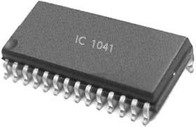
THIRD GENERATION (1964 – EARLY 1970S): INTEGRATED CIRCUITS
25
Hardware Technology - Use of integrated circuits(IC) which consists of a single chip (usually silicon) with many components such as transistors and resistors fabricated on it.
It replaced several individually wired transistors. This development made computers smaller in size, reliable, and efficient.
Instead of punched cards and printouts, users interacted with third generation computers through keyboards and monitors and interfaced with operating system.
This allowed the device to run many different applications at one time with a central program that monitored the memory. For the first time, computers became accessible to mass audience because they were smaller and cheaper than their predecessors.
Examples: NCR 395 and B6500.

Slide 27
Characteristics of Third Generation Computers
26
These computers were based on integrated circuit (IC) technology.
They were able to reduce computational time from microseconds to nanoseconds.
They were easily portable and more reliable than the second generation.
These devices consumed less power and generated less heat. In some cases, air
conditioning was still required.
The size of these computers was smaller as compared to previous computers.
Since hardware rarely failed, the maintenance cost was quite low.
Extensive use of high-level languages became possible.
Manual assembling of individual components was not required, so it reduced the large requirement of labour and cost. However, highly sophisticated technologies were required for the manufacture of IC chips.
Commercial production became easier and cheaper.

Slide 28
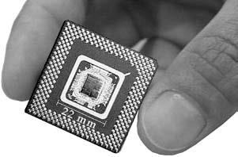
FOURTH GENERATION (EARLY 1970S–TILL DATE): MICROPROCESSORS
27
Also based on the integrated circuit but ICs have been made readily available to us because of the development of the microprocessor (circuits containing millions of transistors).
This generation led to an era of Large Scale Integration (LSI) and Very Large Scale Integration (VLSI) technology
 This generation also saw the development of the GUIs (Graphical User
Interfaces), mouse, and handheld devices.
Despite many advantages, this generation required complex and sophisticated technology for the manufacturing of CPU and other components.
Examples: Apple II, Altair 8800, and CRAY-1.
Jain (Deemed-to-be University), Department of BCA
MICROPROCESSORS

Slide 29
Characteristics of Fourth Generation Computers
28
Fourth generation computers are microprocessor-based systems.
These computers are very small.
Fourth generation computers are the cheapest among all the other generations.
They are portable and quite reliable.
These machines generate negligible amount of heat, hence they do not require air
conditioning.
Hardware failure is negligible, so minimum maintenance is required.
The production cost is very low.
GUI and pointing devices enable users to learn to use the computer quickly.
Interconnection of computers leads to better communication and resource sharing.

Slide 30
FIFTH GENERATION (PRESENT AND BEYOND): ARTIFICIAL INTELLIGENCE
29
These are the objectives for creating the fifth generation of computers are :
To create a human-like computer that would be capable of reasoning and reaching a decision through a series of “what-if-then” analyses has existed since the beginning of computer technology.
To learn from its mistakes and possess the skill of experts.
The starting point for the fifth generation of computers has been set in the early 1990s.
The process of developing fifth generation of computers is still in the development stage.
However, the expert system concept is already in use.
The expert system is defined as a computer information system that attempts to mimic the thought process and reasoning of experts in specific areas.

Slide 31
Characteristics of Fifth Generation Computers
30
Mega Chips: Fifth generation computers will use Super Large Scale Integrated (SLSI) chips, which will result in the production of microprocessor having millions of electronic components on a single chip. In order to store instructions and information, fifth generation computers require a great amount of storage capacity. Mega chips may enable the computer to approximate the memory capacity of the human mind.
Parallel Processing: Most computers today access and execute only one instruction at a time. This is called serial processing. However, a computer using parallel processing accesses several instructions at once and works on them at the same time through the use of multiple central processing units.
Artificial Intelligence (AI): It refers to a series of related technologies that tries to simulate and reproduce human behaviour, including thinking, speaking and reasoning. AI comprises a group of related technologies: expert systems (ES), natural language processing (NLP), speech recognition, vision recognition, and robotics.

Slide 32
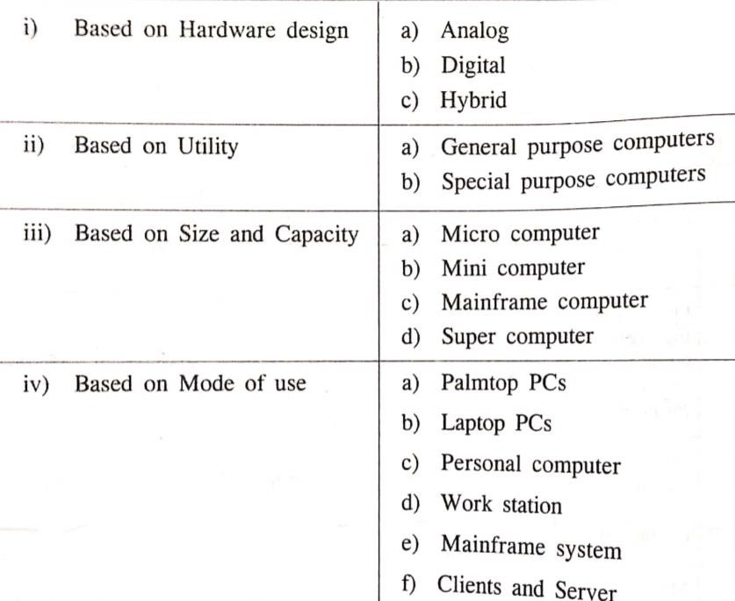
CLASSIFICATION OF COMPUTERS
31

Slide 33
Based on Hardware Design : Analog Computers
32
Represents data as variable across a continuous range of values
Used for measuring parameters that vary continuously in real time, such as temperature, pressure and voltage
More flexible but less precise
It operates by measuring

Slide 34
Based on Hardware Design : Digital Computers
33
Uses distinct values to represent data internally. All information are represented using 0s and 1s.
It operates by counting.
High speed and more accurate

Slide 35
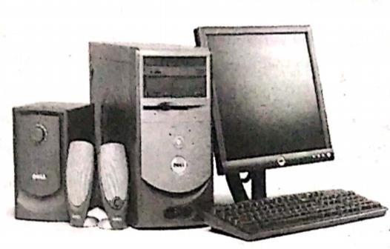
Based on Hardware Design : Hybrid Computers
34
In Hybrid Computer, an attempt is made to combine the qualities of
both analog and digital computer
Measuring functions are performed by the analog way, while control and logic functions are digital in nature

Slide 36
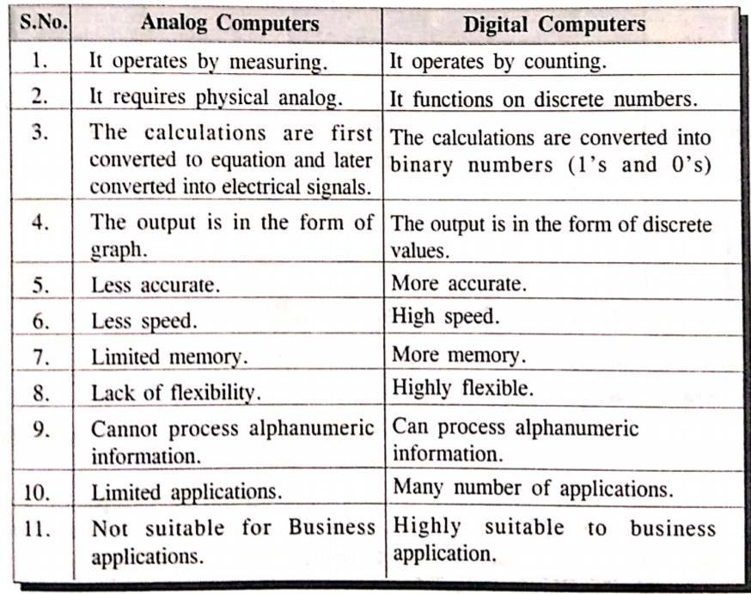
Difference between Analog and Digital Computers
35

Slide 37
Based on Utility : General Purpose Computer
36
Designed and constructed to cater almost all the needs of the society.
Able to perform according to the programs created to meet different needs
Eg : financial accounting, mathematical calculation, designing textile prints, controlling machinery etc.

Slide 38
Based on Utility : Special Purpose Computer
37
Designed to preform special functions. In such devices instructions are permanently programmed.
The instructions needed to perform the particular task are incorporated into the internal memory of the computer
Eg : Aircraft control system, electronic voting machine

Slide 39
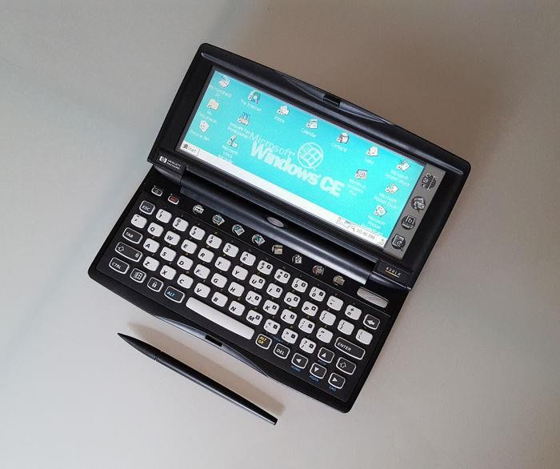
Based on Mode of Use : Palmtop Computer
38
Accepts handwritten inputs using an electronic pen
These have small disk storage and can be connected to a wireless network.
One has to train the system on user’s handwriting before it can be used
Also can be used as a mobile phone, email, fax
Microsoft Operating System used – Windows CE

Slide 40
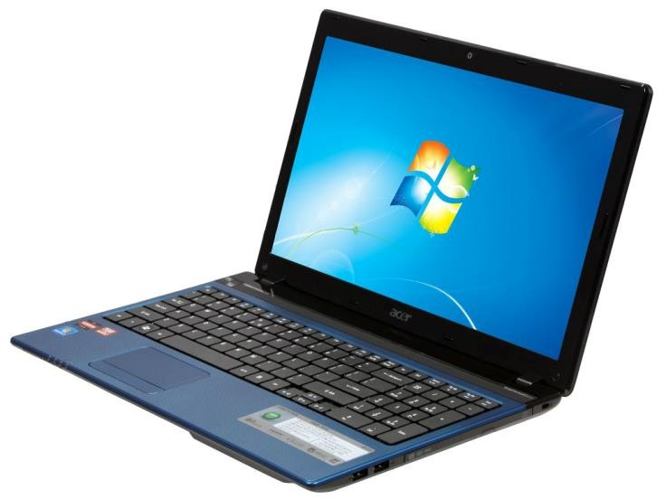
Based on Mode of Use : Laptop Computer
39
Also known as Notebook Computers
Small in size ,portable, has battery backup and has all the functionalities of a desktop
They use a keyboard, flat screen liquid crystal display, and a Pentium processor
Can be connected to network

Slide 41
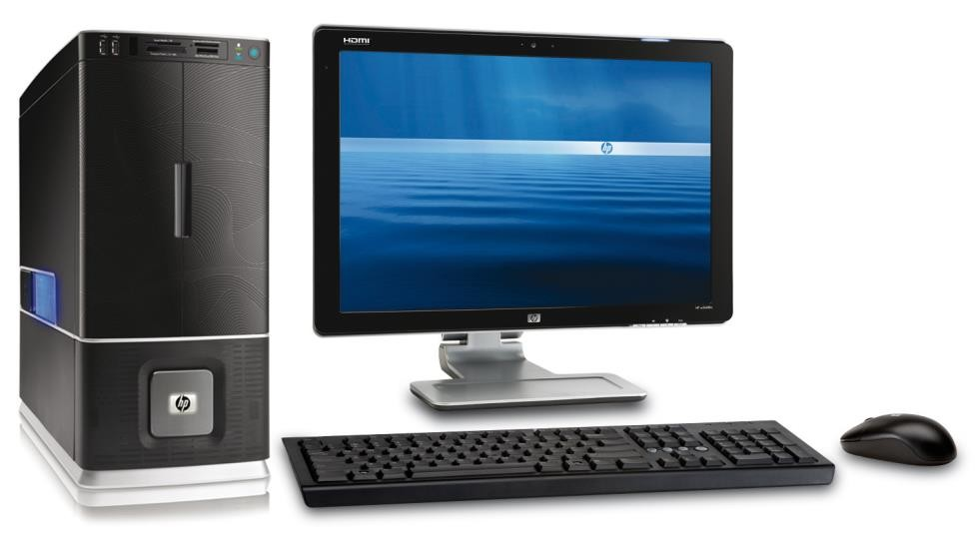
Based on Mode of Use :Personal Computers
40
Designed to meet the personal computing requirements of users at working place or at home
It is a stand-alone, Non-portable, general purpose computer that can be placed on the desk
The personal computers configuration varies from one PC to another PC depending on their use.
Externally, it consists of three units—keyboard, monitor, and a system unit containing the
CPU, memory, hard disk drive, etc.
It is not very expensive and is suited to the needs of a single user at home, small business units, and organizations.
Apple, Microsoft, HP, Dell and Lenovo are some of the PC manufacturers. .
IBM was the first computer to introduce and popularize use of desktops.

Slide 42
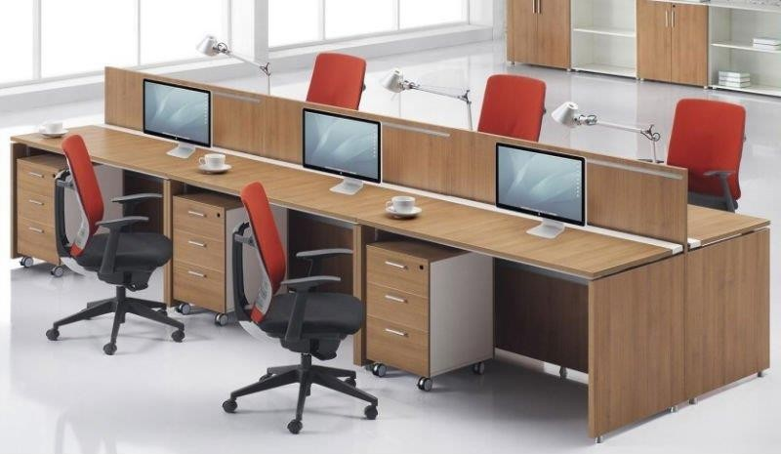
Based on Mode of Use : Work Stations
41
Powerful desktop computer designed to meet the computing need of users or clients with better processing, high storage capacity and with efficient and effective graphics display facility.
Looks similar to a personal computer and can be used by only one person at a time through LAN
Used for engineering applications (CAD/CAM), desktop publishing, software development, and other such types of applications which require a moderate amount of computing power and relatively high-quality graphics capabilities.
Workstations generally come with a large, high-resolution graphics screen, a large amount of RAM, inbuilt network support, and a graphical user interface. Most workstations also have mass storage device such as a disk drive, but a special type of workstation, called diskless workstations, comes without a disk drive
Common operating systems for workstations are UNIX and Windows NT. Like PC, workstations are also single-user computers like PC but are typically linked together to form a local area network, although they can also be used as stand-alone systems.

Slide 43
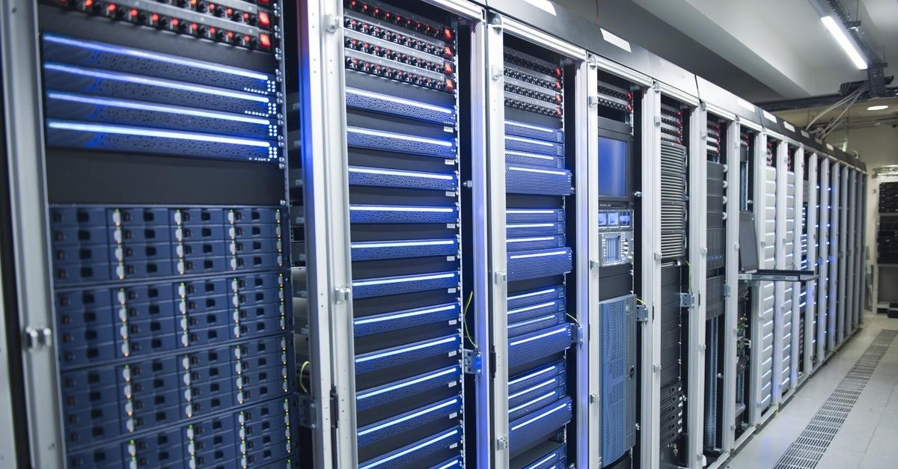
Based on Mode of Use : Mainframe Computers
42
Commonly used for handling voluminous data and in an environment where a large no.of users
need to share a common computing facility.
It is housed in a central location with several user terminals and peripherals connected to it.
The user terminals are connected with the host processor for accessing as and when required.
Used by organizations like banks, airlines and railways to handle millions and trillions of online
transactions per second.
Some examples of mainframes are CDC 6600 and IBM ES000 series.

Slide 44
Based on Mode of Use : Mainframe Computers
43
multi-user, multiprogramming and high performance computers.
They operate at a very high speed, have very large storage capacity and can handle the workload of many users.
Large and powerful systems generally used in centralized databases.
The user accesses the mainframe computer via a terminal that may be a dumb terminal, an intelligent terminal or a PC. A dumb terminal cannot store data or do processing of its own. It has the input and output device only. An intelligent terminal has the input and output device, can do processing, but, cannot store data of its own. The dumb and the intelligent terminal use the processing power and the storage facility of the mainframe computer. Mainframe computers are used in organizations like banks or companies, where many people require frequent access to the same data.
Important features of mainframes are −
Big in size
Hundreds times Faster than servers, typically hundred megabytes per second
Very expensive
Use proprietary OS provided by the manufacturers
In-built hardware, software and firmware security features

Slide 45
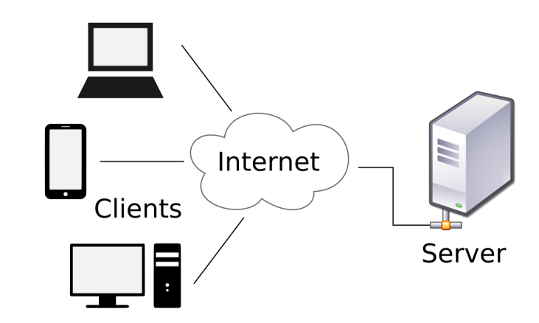
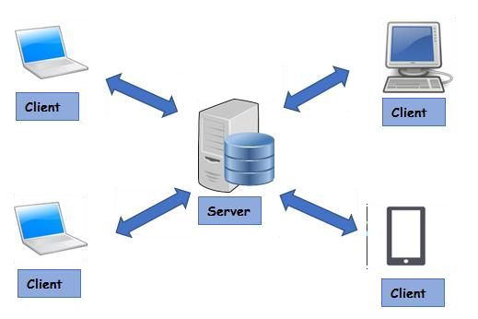
Based on Mode of Use : Clients and Servers
44
With the increased gain of computer networks, it is possible to interconnect several computers for communicating over the networks to share the several resources or services among the multiple user.
Server – A large computer that manages a shared resources and provides a set
of shared user services to the client
Client – A single user personal computer or workstation and supports a user friendly interface to the end user.It sends request to the server and then gain access with the server.

Slide 46









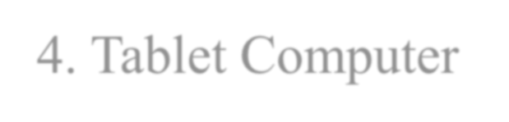
Based on Size and Capacity : Micro Computers
45
Small, low-cost, single user, digital computers consists of CPU, input unit, output unit, storage unit and software
They can be connected together to create network of computers that can serve more than one user. Eg : IBM PC based on Pentium processor,Apple Macintosh
Types of Microcomputer :-
1. Desktop Computer/Personal Computer(PC)
2. Notebook Computers/Laptop
3. Netbook- Smaller notebooks optimized forlow weight and low cost and are designed to accessing web-based applications like video streaming,email,web surfing and instant messaging
4. Tablet Computer – has features of the notebook but it can accept input from a stylus or a pen

Slide 47

Based on Size and Capacity : Micro Computers
46
5. Handheld Computer / Personal Digital Assistant(PDA)
Small computer that can be held on the top of the palm.
Uses stylus or a pen instead of keyboard.
Does not have disk drive.
Have limited memory and less powerful
Can be connected to internet vis wireless connection.
Over last few years PDAs are merged into mobile phones to create smart phones
Eg : Casio,Apple
6. Smart Phones
Cellular phones that function both as a phone and a small PC
May use stylus or a pen or have a small keyboard
Accessibility to internet

Slide 48
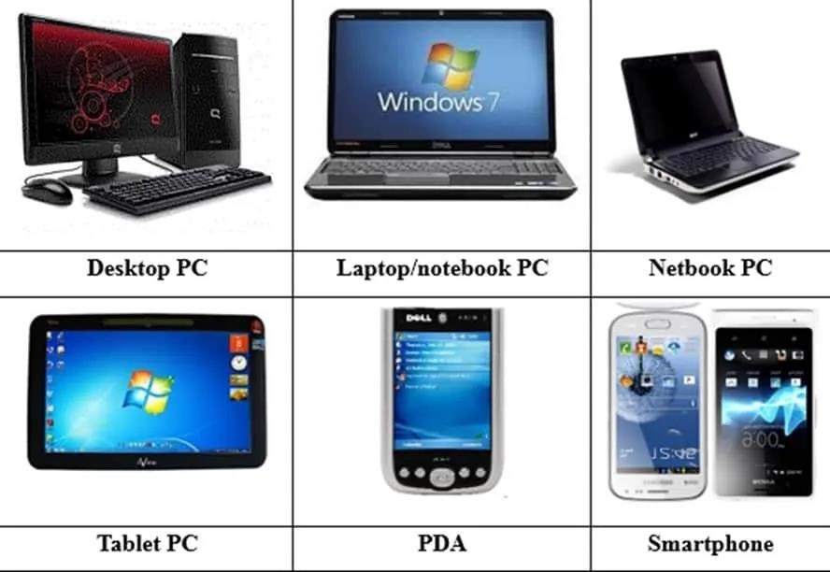
Types of Microcomputer
47

Slide 49
Based on Size and Capacity : Mini Computers
48
Digital computers generally used in multi-user systems
High storage capacity, high processing speed than micro computers
Support 4-200 users simultaneously
Users can access mini computer through their PCs or terminals
Used for real time applications in industry,research centres etc.
Eg : PDP 11,IBM(8000 Series)

Slide 50
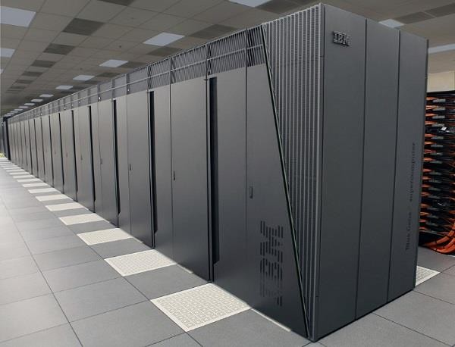
Based on Size and Capacity : Supercomputers
49
Fastest,costliest and most powerful computers available on Earth.
Used for carrying out complex, fast and time intensive calculations for scientific and engineering applications.
Supercomputer’s speed/ performance is measured in teraflops, i.e. 1012 floating point operations
per second.
Fugaku is the world’s fastest supercomputer with a rating 148.6 PetaFLOPS, i.e. 148.6 quadrillion floating point operations per second.
Most common uses of supercomputers include Molecular mapping and research,Weather forecasting, Environmental research, Oil and gas exploration, solve multi-variant mathematical problems of existent physical processes, such as aerodynamics, metrology, and plasma physics and for military strategists to simulate defence scenarios.

Slide 51
Based on Size and Capacity : Supercomputers
50
Super computers are the special purpose machines, which are specially designed to maximise the numbers of FLOPS (Floating Point Operation Per Second). Any computer below one gigaflop/sec is not considered a super computer.
It basically contains a number of CPUs that operate in parallel to make it faster. Its processing speed lies in the range of 400–10,000 MFLOPS (Millions of Floating Point Operation Per Second). Due to this feature, super computers help in many applications such as information retrieval computer-aided design.
A super computer can process a great deal of information and make extensive calculations very, very quickly. They can resolve complex mathematical equations in a few hours, which would have taken a. Cinematic specialists use them to produce sophisticated movie animations. Scientists build complex models and simulate them in a super computer.
Examples of super computers are CRAY–3, Cyber 205, and PARAM.
PARAM is a series of supercomputer assembled in India by C-DAC in Pune.Param Padma is the latest machine in this series. It has 1 Tera FLOP computing power.

Slide 52
Applications of Computer
51

Slide 53
Office Automation
Essential requirements of today's office environment are
To reduce cost of administrative overhead;
To increase the efficiency of office tasks;
52
To provide better service to the customers;
To provide accurate information to the management;
To provide best and fastest way of communication.
The basic functions, which are needed to be automated in any office are
Document Generation: Typewriters, computers and printers are widely used in automating this routine task of offices.
Document Processing- word processing, desktop publishing etc. are used to perform this task.
Document Distribution: All offices require an electronic distribution system for transferring documents and data within and outside the organization. Eg: Photocopiers, Teletax and Fax machines.
Archival Storage: The office documents are also needed to be stored for a long period, so that they can be retrieved when required. This task is achieved by the use of different storage devices like tapes, disks etc.

Slide 54
Data Processing
53
Data processing is the collection and manipulation of items of data to produce meaningful information.
Computerized data processing, or Electronic data processing represents a later development, with a computer used instead of several independent pieces of equipment.
Data processing, Manipulation of data by a computer. It includes the conversion of raw data to machine-readable form, flow of data through the CPU and memory to output devices, and formatting or transformation of output.

Slide 55
Information processing
54
Information processing refers to the manipulation of digitized information by computers and other digital electronic equipment
Information processing systems include business software, operating systems, computers, networks and mainframes. Whenever data needs to be transferred or operated upon in some way, this is referred to as information processing
Information processing began decades ago as businesses and governments sought to be able to process large amounts of data, often statistical or calculated from gathered data.

Slide 56
Engineering/Architecture/Manufacturing
55
 The architects and engineers are extensively using computers in designing and drawings.
Computers can create objects that can be viewed from all the three dimensions. By using techniques like virtual reality, architects can explore houses that have been designed but not built.
The manufacturing factories are using computerized robotic arms in order to perform hazardous jobs.

Slide 57
Commercial Use
56
Communication: E-mail or Electronic Mail is one of the communication media in which computer is used. Through e-mail, messages and reports are passed from one person to one or more persons with the aid of computer and telephone line.
Business Application: This is one of the important uses of the computer. Initially, computers were used for batch processing jobs, where one does not require the immediate response from the computer. Currently, computers are mainly used for real time applications (like at the sales counter) that require immediate response from the computer.
Banking: In the field of banking and finance, computers are extensively used. People can use the ATM (Automated Teller Machine) services 24 hours of the day in order to deposit and withdraw cash.
Notes:
Communication: E-mail or Electronic Mail is one of the communication media in which computer is used. Through e-mail, messages and reports are passed from one person to one or more persons with the aid of computer and telephone line. The advantage of this service is that while transferring the messages it saves time, avoids wastage of paper, and so on. Moreover, the person who is receiving the messages can read the messages whenever he is free and can save it, reply it, forward it or delete it from the computer.
Business Application: This is one of the important uses of the computer. Initially, computers were used for batch processing jobs, where one does not require the immediate response from the computer. Currently, computers are mainly used for real time applications (like at the sales counter) that require immediate response from the computer. There are various concerns for which computers are used such as in business forecasting, to prepare pay bills and personal records, in banking operations and data storage, in various types of Life Insurance Business, and as an aid to management. Businesses are also using the networking of computers, where a number of computers are connected together to share the data and the information. Use of e-mail and Internet has changed the ways of doing business.
Banking: In the field of banking and finance, computers are extensively used. People can use the ATM (Automated Teller Machine) services 24 hours of the day in order to deposit and withdraw cash. When the different branches of the bank are connected through the computer networks, the inter branch transactions such as cheque and draft can be performed by the computers without any delay.

Slide 58
Medicine and Health Care
57
 There has been an increasing use of computers in the field of medicine. Now, doctors are using computers right from diagnosing the illness to monitoring a patient's status during complex surgery.
By using automated imaging techniques, doctors are able to look inside a person's body and can study each organ in detail (such as CAT scans or MRI scans), which was not possible few years ago.
There are several examples of special purpose computers that can operate within the human body such as a cochlear implant, a special kind of hearing aid that makes it possible for deaf people to hear.

Slide 59
Education
58
Computers have also revolutionized the whole process of education. Currently, the classrooms, libraries, and museums are utilizing computers to make the education much more interesting.
Unlike recorded television shows, Computer Aided Education (CAE) and Computer Based Training (CBT) packages are making learning much more interactive.

Slide 60
Entertainment
59
 Computers are finding greater use in entertainment industry. They are used to control the images and sounds.
The special effects, which mesmerise the audience, would not have been possible without the computers. In addition, computerised animation and colourful graphics have modernised the film industry.

Slide 61
Other Applications
60
Science: Scientists have been using computers to develop theories, to analyse, and test the data. The fast speed and the accuracy of the computer allow different scientific analyses to be carried out.
Publishing: Computers have created a field known as DTP (Desktop Publishing). In DTP, with the help of computer and a laser printer one can perform the publishing job all by oneself.
Sports: A computer can be used to watch a game, view the scores, improve the game, play games (like chess, etc.) and create games. They are also used for the purposes of training players.
Advertising: Computer is a powerful advertising media. Advertisement can be displayed on different websites, electronic-mails can be sent and reviews of a product by different customers can be posted. Computers are also used to create an advertisement using the visual and the sound effects.), Department of BCA
Notes:
Science: Scientists have been using computers to develop theories, to analyze, and test the data. The fast speed and the accuracy of the computer allow different scientific analyses to be carried out. They can be used to generate detailed studies of how earthquakes affect buildings or pollution affects weather pattern. Satellite-based applications have not been possible without the use of computers. It would also not be possible to get the information of our solar system and the cosmos without computers.
Publishing: Computers have created a field known as DTP (Desktop Publishing). In DTP, with the help of computer and a laser printer one can perform the publishing job all by oneself. Many of the tasks requiring long manual hours such as making table of contents and index can be automatically performed using the computers and DTP software.
Sports: A computer can be used to watch a game, view the scores, improve the game, play games (like chess, etc.) and create games. They are also used for the purposes of training players.
Advertising: Computer is a powerful advertising media. Advertisement can be displayed on different websites, electronic-mails can be sent and reviews of a product by different customers can be posted. Computers are also used to create an advertisement using the visual and the sound effects. For the advertisers, computer is a medium via which the advertisements can be viewed globally. Web advertising has become a significant factor in the marketing plans of almost all companies. In fact, the business model of Google is mainly dependent on web advertising.

Slide 62
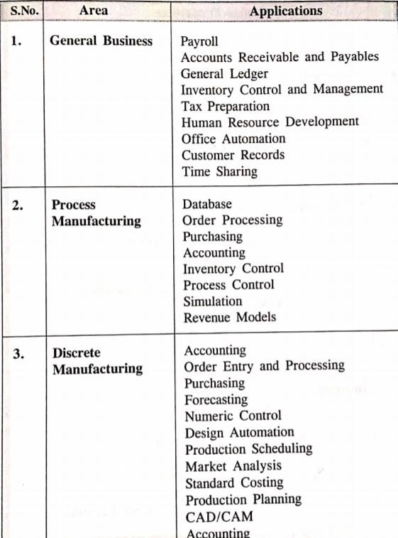
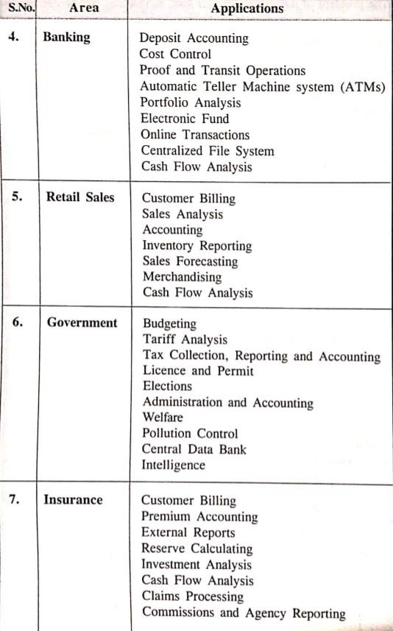
61

Slide 63
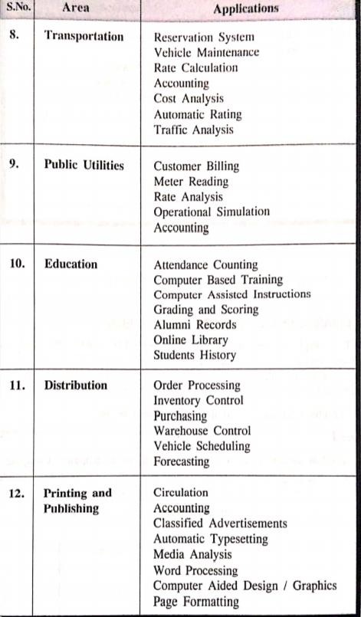
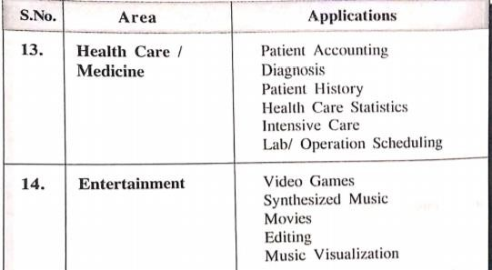
62

Slide 64
Module I : Introduction to Computers 8 Hours
63
General features of a computer.
Generation of computers, Personal computer, workstation, mainframe computer and super computers.
Computer applications, Data processing, information processing, commercial, office
automation, industry and engineering, healthcare, education, graphics and multimedia.

Slide 65








THANK YOU
64

